Slide 1
Predpovedanie srdcových chorôb
Tomáš Bielik

Slide 2
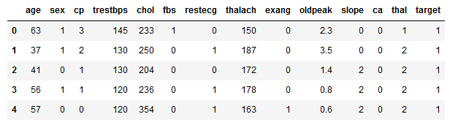
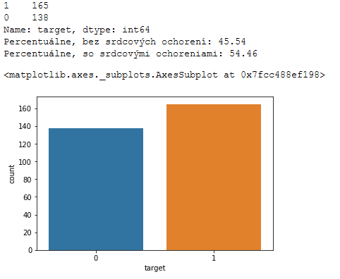
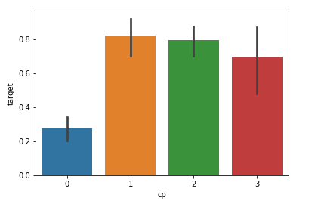
Dataset

Slide 3
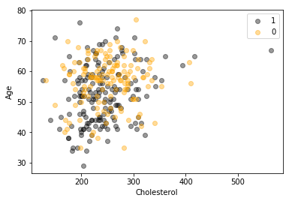
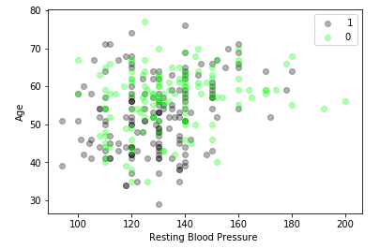
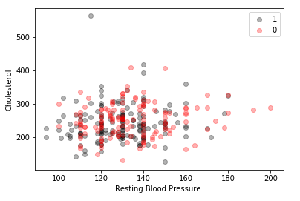

Slide 4
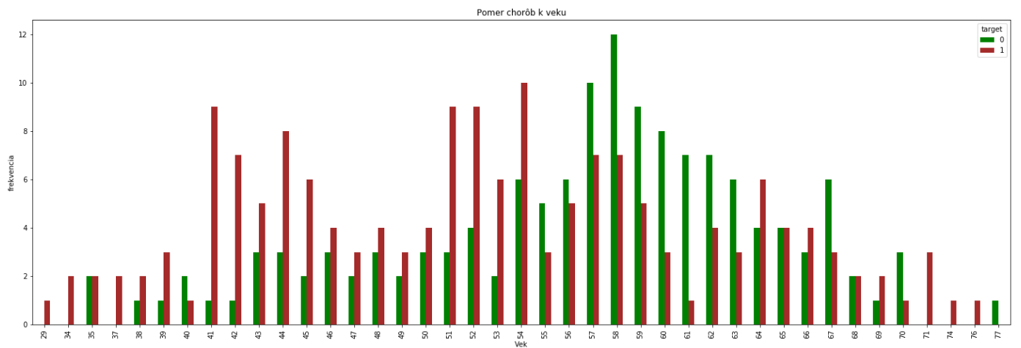

Slide 5
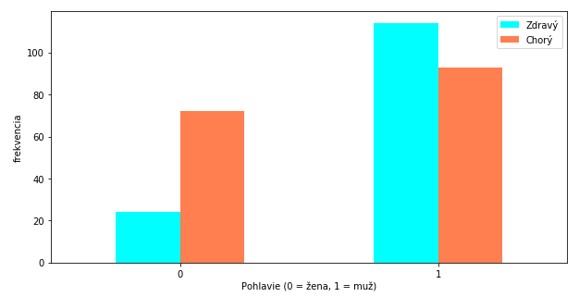
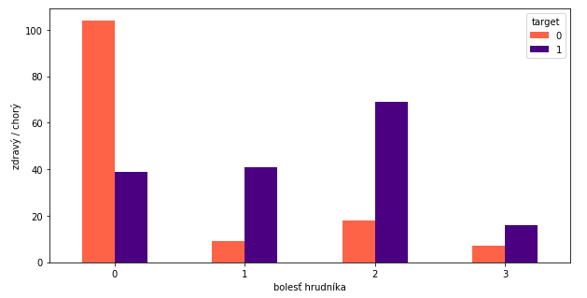

Slide 6
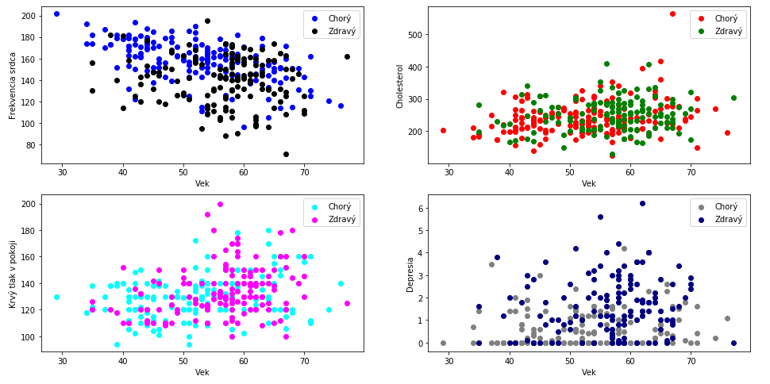

Slide 7
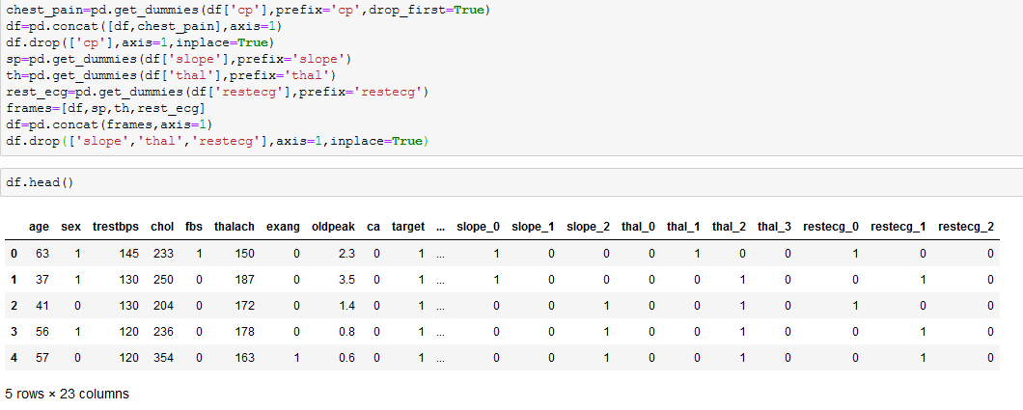
Predpríprava dát

Slide 8
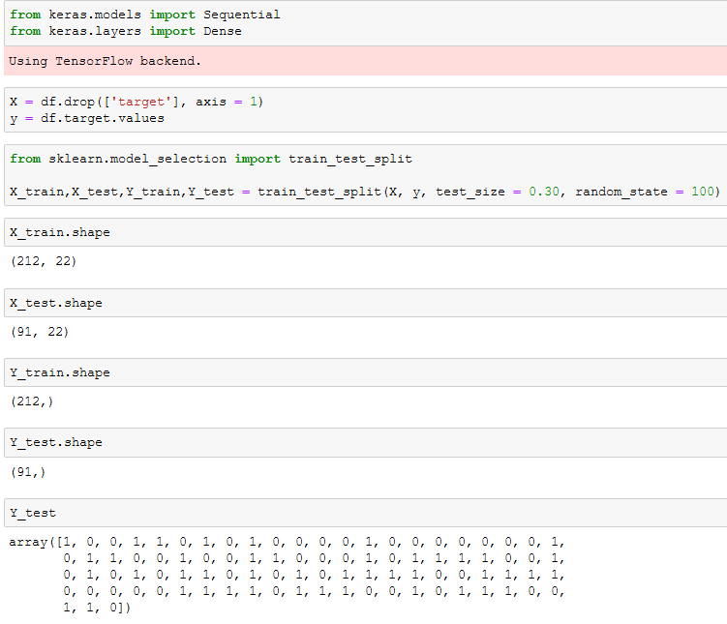

Slide 9
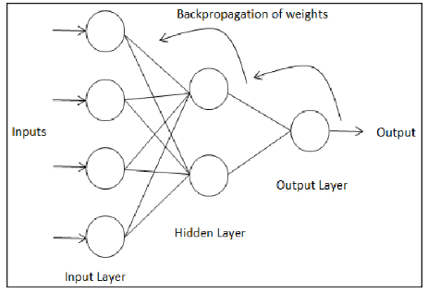
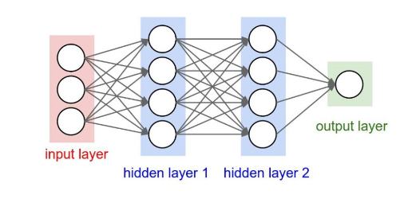
Neurónová sieť
f(x)=x

Slide 10
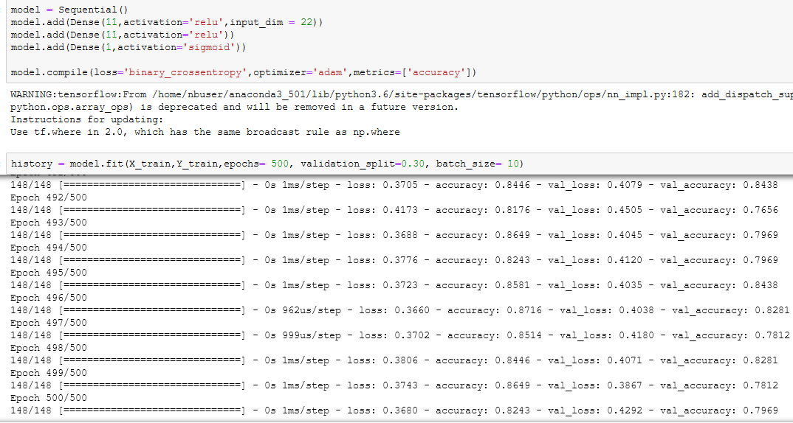

Slide 11
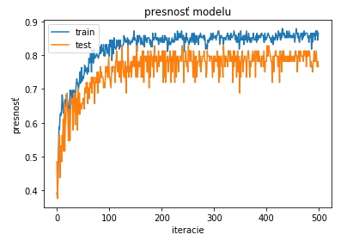
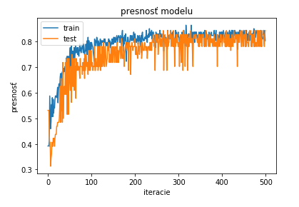
Výsledky
zobrazenie a porovnanie dvoch výsledkov

Slide 12
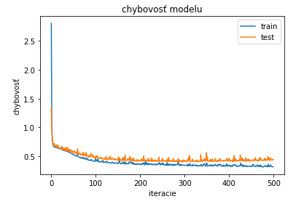
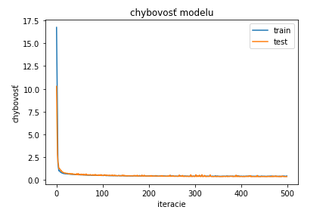

Slide 13
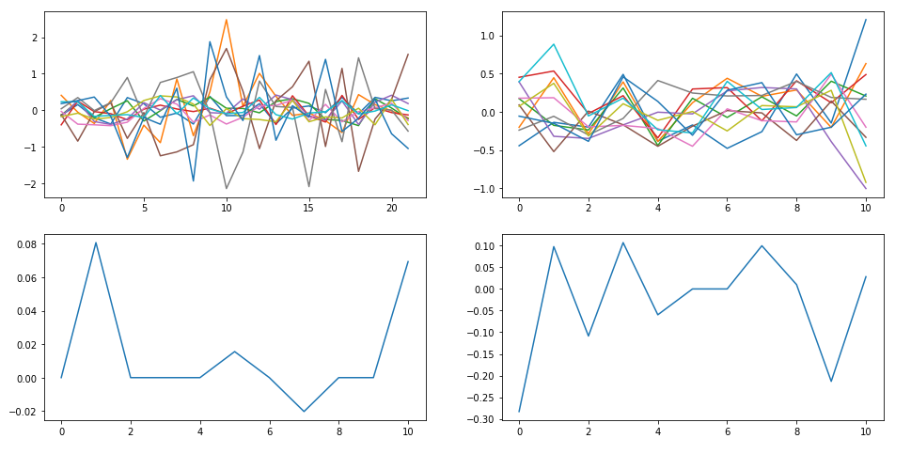
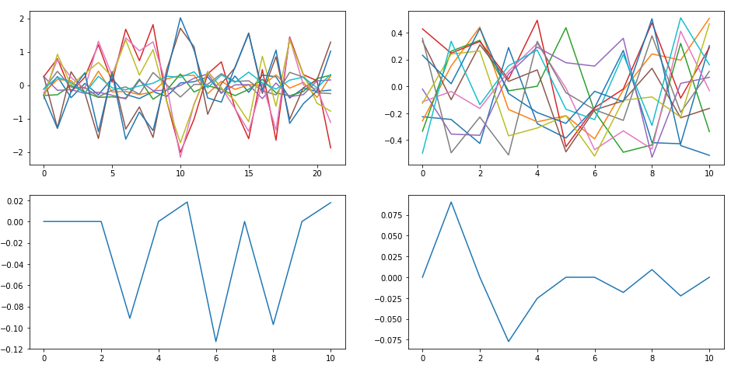

Slide 14
Ďakujem za pozornosť

Slide 15
zdroje
https://machinelearningmastery.com/display-deep-learning-model-training-history-in-keras/
https://www.tensorflow.org/api_docs/python/tf/keras/backend
https://scikit-learn.org/stable/modules/generated/sklearn.model_selection.train_test_split.html
https://keras.io/api/utils/backend_utils/
https://machinelearningmastery.com/tensorflow-tutorial-deep-learning-with-tf-keras/
https://machinelearningmastery.com/how-to-control-the-speed-and-stability-of-training-neural-networks-with-gradient-descent-batch-size/
https://www.kaggle.com/ronitf/heart-disease-uci

